Slide 1


Customer Intention E-Commerce
Dendy Dwinanda
RMT-030

Slide 2
Analysis SMART
Specific = Make predictions on the purchase intention of online consumers in an e-commerce.
Measurable = Analyze the behavior between web users on purchasing decisions.
Achievable = Get prediction results from each web user data in purchasing decisions.
Relevant = Helps related departments to see consumer behavior in predicting constumer decisions.
Time-bound = The prediction model will be evaluated in the next 3 months to improve the accuracy of the analysis.

Slide 3
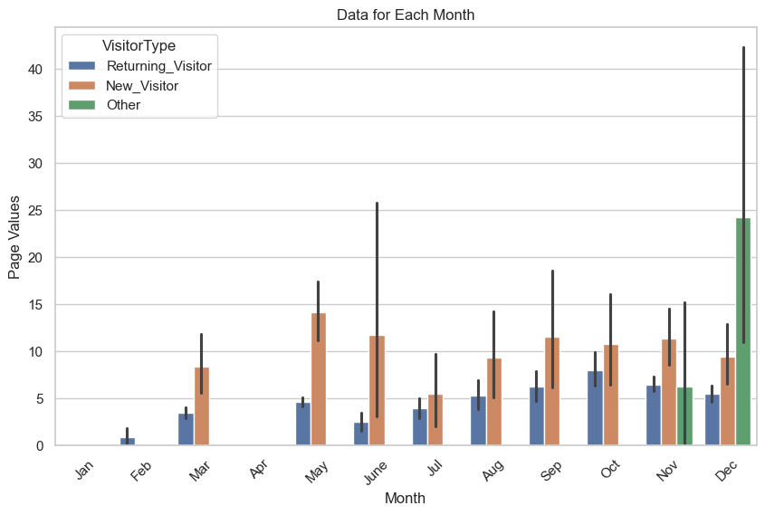
Page Value

Slide 4
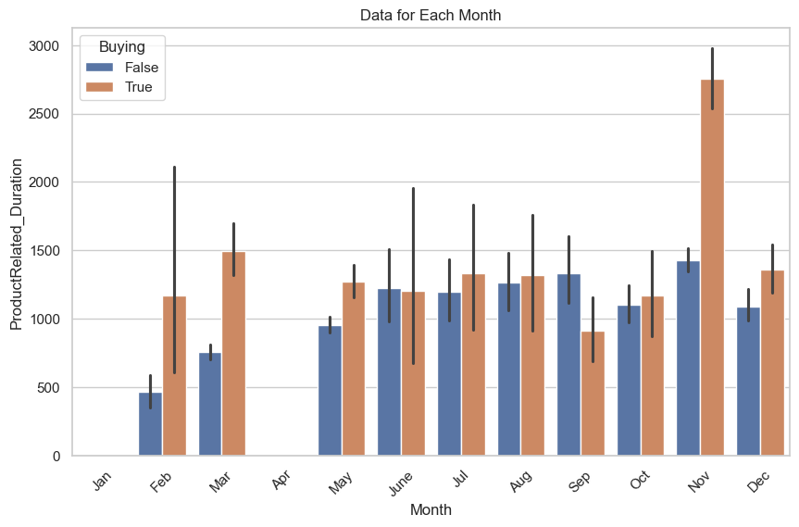
Product Related Duration

Slide 5
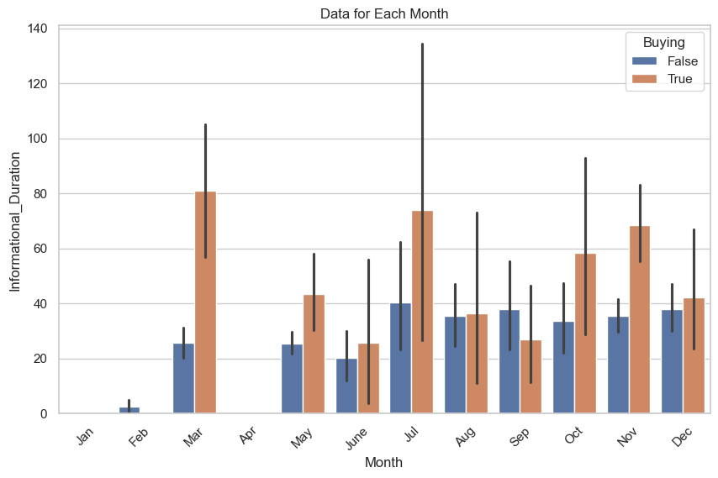
Informational Duration

Slide 6
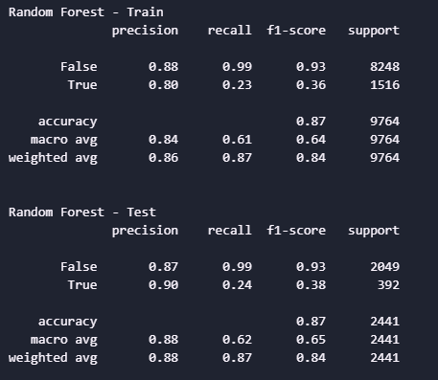
Train VS Test Boosting Model

Slide 7
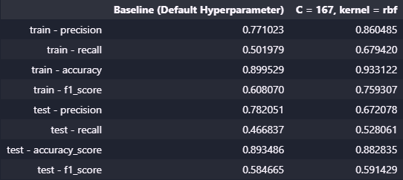
Train VS Test Best Model

Slide 8
Conclusion
The model is made to predict web visitors but not make a purchase. make management can see the behavior of web visitors and can make the right treatment for visitors who make purchases and do not do it.
Model weaknesses
Not yet able to predict visitors who make purchases well, assuming that the distribution of data that makes purchases is uneven.

